Slide 1
Experiment 1
Introduction to MATLAB
Matrix Laboratory

Slide 2
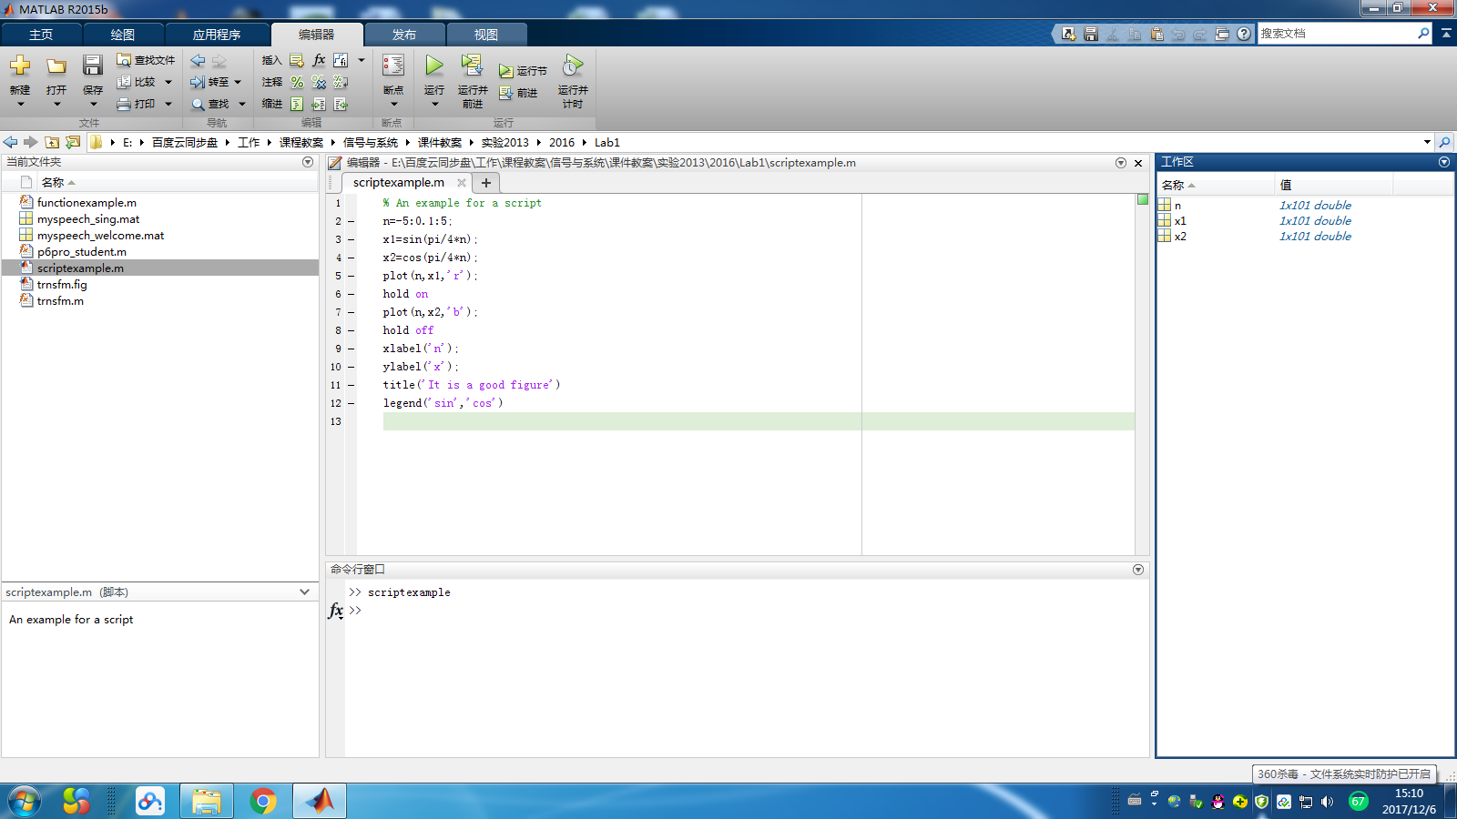
1. Preliminary of MATLAB
Current folder
Editor
Workspace
Current folder
Command window
主页-布局-默认

Slide 3
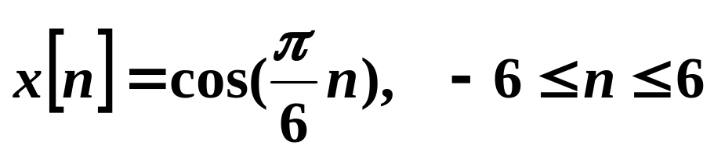
1.1 Representing a signal
>> a = 1.25+ 2.36*j ; b = cos(pi/3) %scalar
>> n= -6:1:6 % n is a vector, from -6 to 6
>> x= cos(pi/6*n) % x is also a vector

Slide 4
>> help stem
>> help plot
>> plot(x) %注意横坐标
>> figure %打开一张新图
>> plot(n,x) %注意横坐标
>> xlabel('n');
>> ylabel('x');
>> title('It is a good figure')

Slide 5
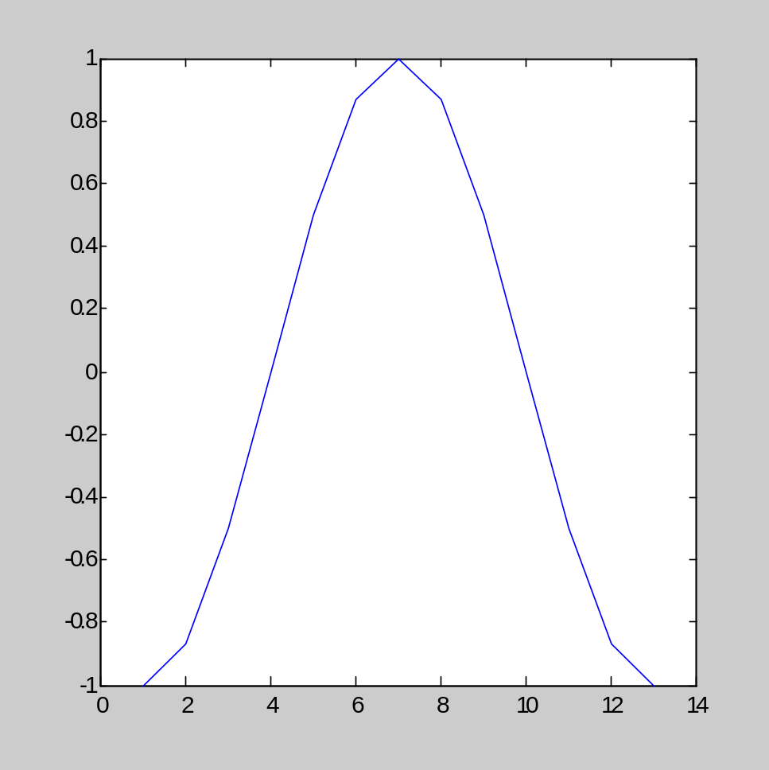
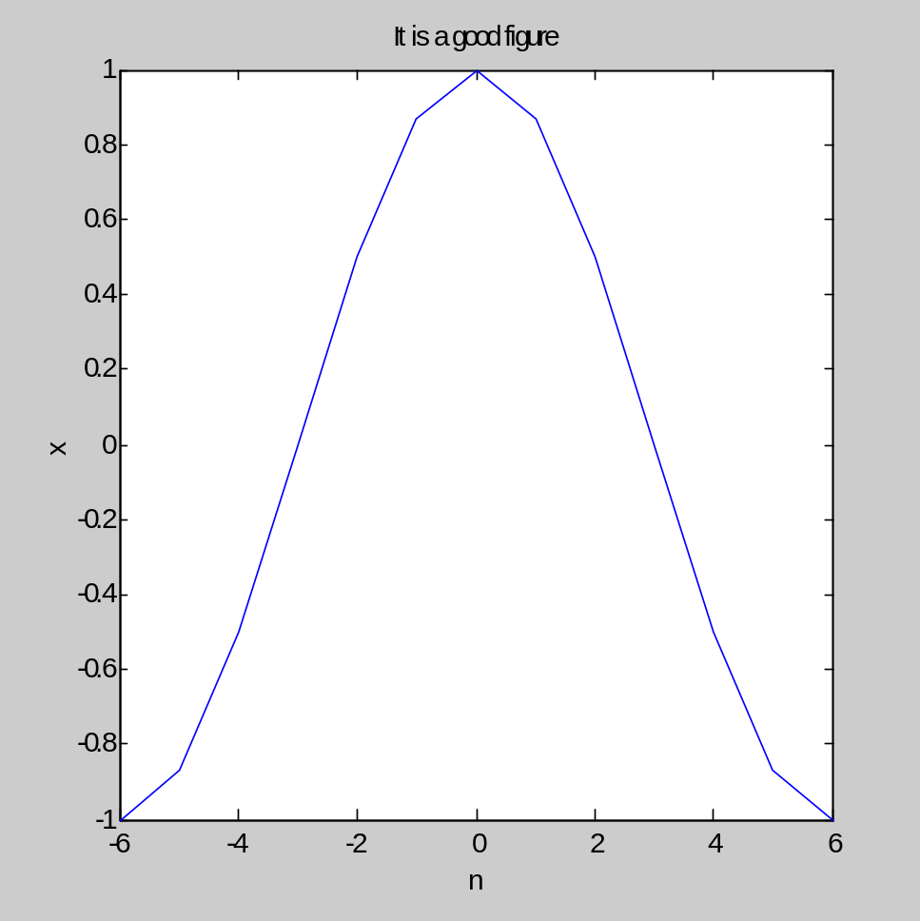

Slide 6
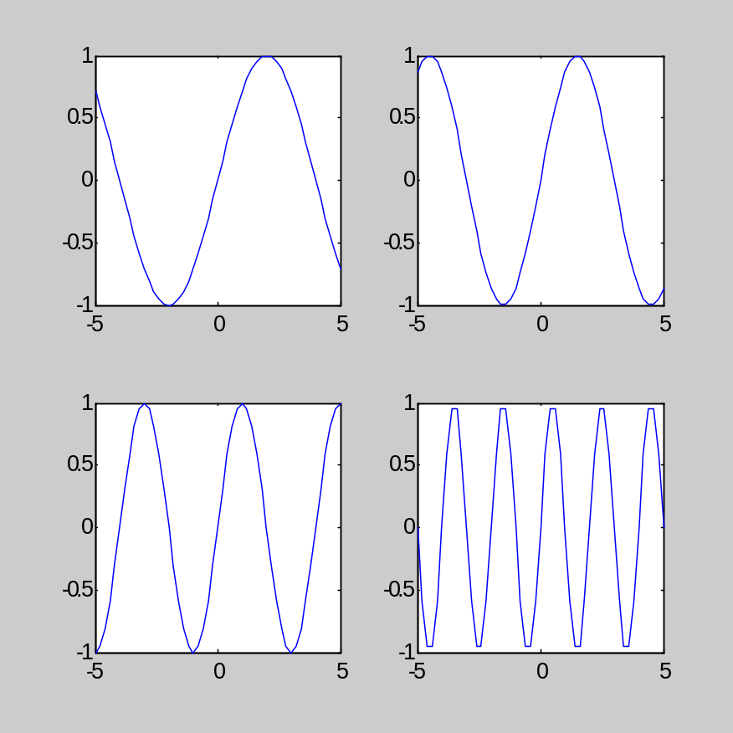
Practices 1: subplot(m,n,p)
>> n=-5:0.2:5
>> x1=sin(pi/4*n);
>> x2=sin(pi/3*n);
>> x3=sin(pi/2*n);
>> x4=sin(pi/1*n);
>>subplot(2,2,1);plot(n,x1);
>>subplot(2,2,2);plot(n,x2);
>>subplot(2,2,3);plot(n,x3);
>>subplot(2,2,4);plot(n,x4)

Slide 7
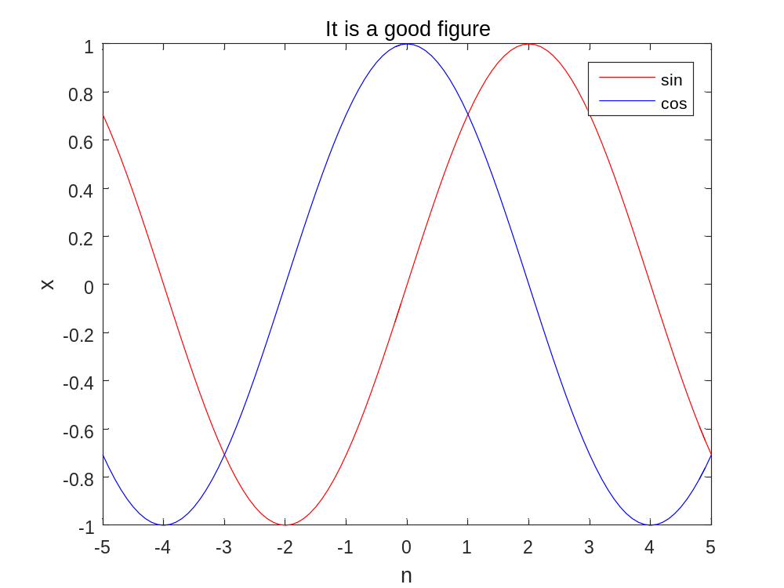
Practices 1: hold on
>> n=-5:0.2:5;
>> x1=sin(pi/2*n);
>> x2=cos(pi/2*n);
>> plot(n,x1,'r');
>> hold on
>> plot(n,x2,'b');
>> hold off
>> xlabel('n');
>> ylabel('x');
>> title('It is a good figure')
>> legend('sin','cos')

Slide 8
1.2 Basic operations
>> x = 1.2+3.4*j;
>> x_mag = abs(x); %模，绝对值
>> x_p = angle(x); %相角
>> x_r = real(x); %实部
>> x_i = imag(x); %虚部
>> x_conj = conj(x); %共轭
>> x_round = round(x); %取整（四舍五入）
>> x_floor = floor(x); %取整（最小）
>> x_ceil = ceil(x); %取整（最大）

Slide 9
Scenario1: Vectors (1-D case)
>> a = [1:4] % a=[1 2 3 4]
>> b = [2:5] % b=[2 3 4 5]
>> c = a.*b % 数组相乘
>> d = a’*b % 矩阵相乘 4-by-4 matrix
>> e = a*b’ %矩阵相乘 1-by-1 scalar
>> f=a*b %矩阵相乘 出错

Slide 10
Scenario1: Vectors (1-D case)
>> v=zeros(1,4) %zero vector v=[0 0 0 0]
>> a = [1:4]; % a=[1 2 3 4]
>> a_r = [v, a]; % a_r=[0 0 0 0 1 2 3 4]
>> A_m = [v; a]; %换行
>> g1 = a_r (2:end); % [0 0 0 1 2 3 4]
>> g2 = a_r (2:length(a_r)) ; % [0 0 0 1 2 3 4]

Slide 11
Scenario2: Matrices (2-D case)
>> y = [1-1j, 2+2j, 3-3j; 4+4j, 5-5j, 6+6j; 7-7j, 8+8j, 9-9j]
>> y_t = y.' ; % Transpose matrix of y
>> y_h = y' ; % 共轭转置矩阵

Slide 12
Practices 2:
>> heights =[2.11,1.93,2.03,2.03,1.96];
>> max_height = max(heights)
>> min_height = min(heights)
>> ave_height = mean(heights)

Slide 13
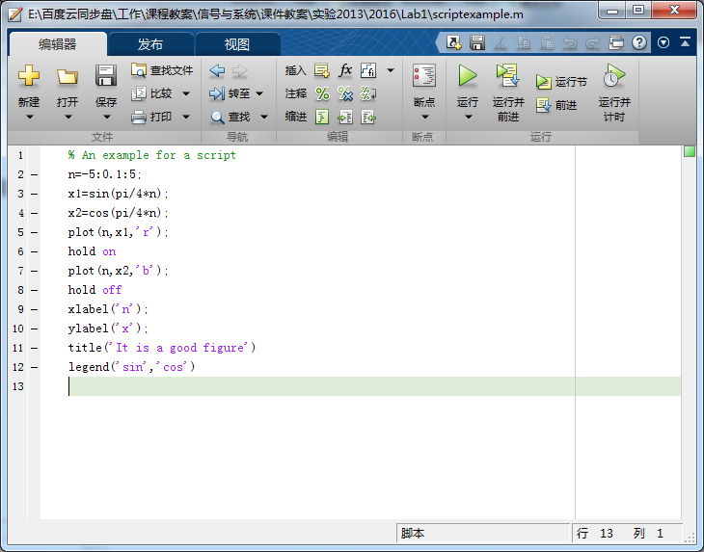
2.Write up your first m-file
scriptexample.m

Slide 15
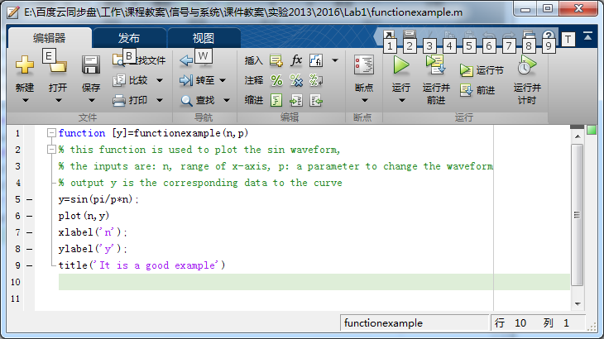
functionexample.m
函数名和文件名相同

Slide 16
>> n=[-5:0.2:5];
>> p=2;
>> [y]=functionexample(n,p);
>> help functionexample
this function is used to plot the sin waveform,
the inputs are: n, range of x-axis, p: a parameter to change the waveform
output y is the corresponding data to the curve

Slide 17
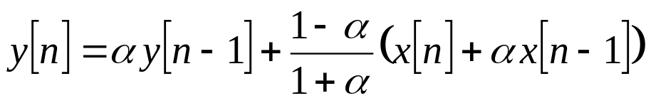

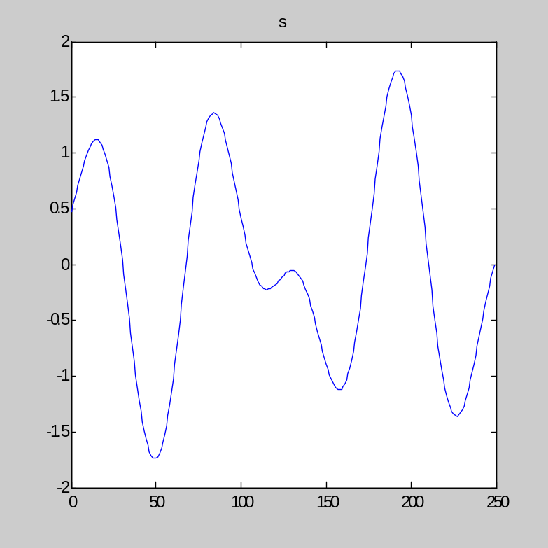
Problem
>>n=0:1:249;
>>s=cos(0.021*pi*n)-0.75*cos(0.035*pi*n+pi/4); %signal
>>e=3.5*cos(pi*n); %noise
>>x=s+e; % signal+ noise
>>plot(n,s)

Slide 18
Filter
function [y]=p6pro_student(x,n,alpha)
N=length(n);
y=zeros(N,1); % initialize output vector y
y(1)=0+(1-alpha)/(1+alpha)*(x(1)+0); % start point of theoutput
for loop=2:N % use for loop to calculate the rest of y
y(loop)=alpha*y(loop-1)+(1-alpha)/(1+alpha)* (x(loop)+alpha*x(loop-1));
% each loop, we calculate one element in y, that is y(loop)
end
figure
plot(n,x)
title('x')
figure
plot(n,y)
title('y')

Slide 19

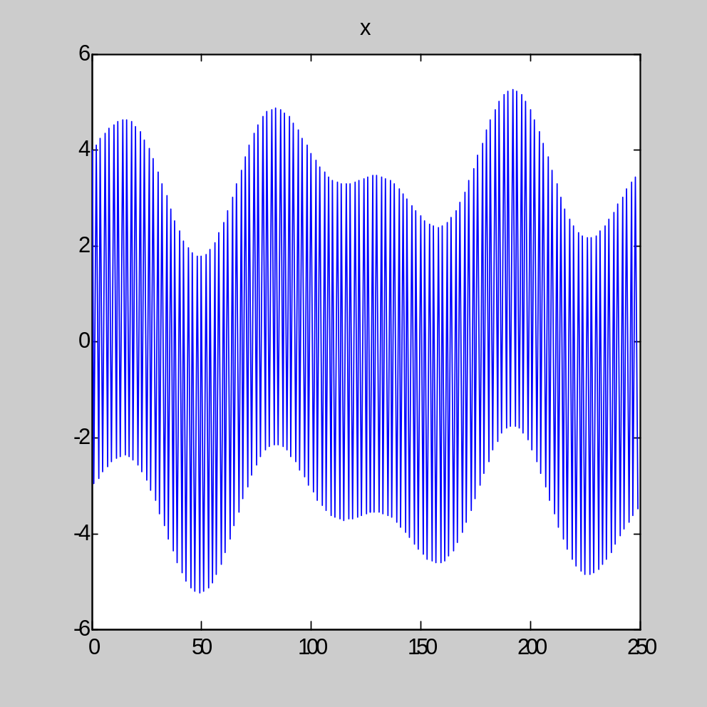
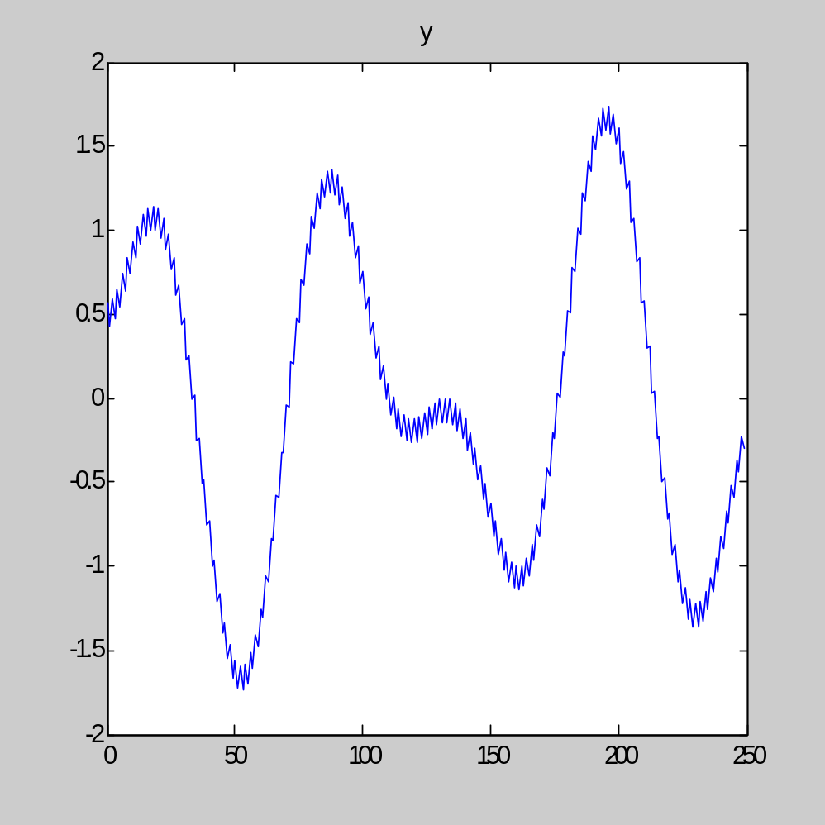

Slide 20

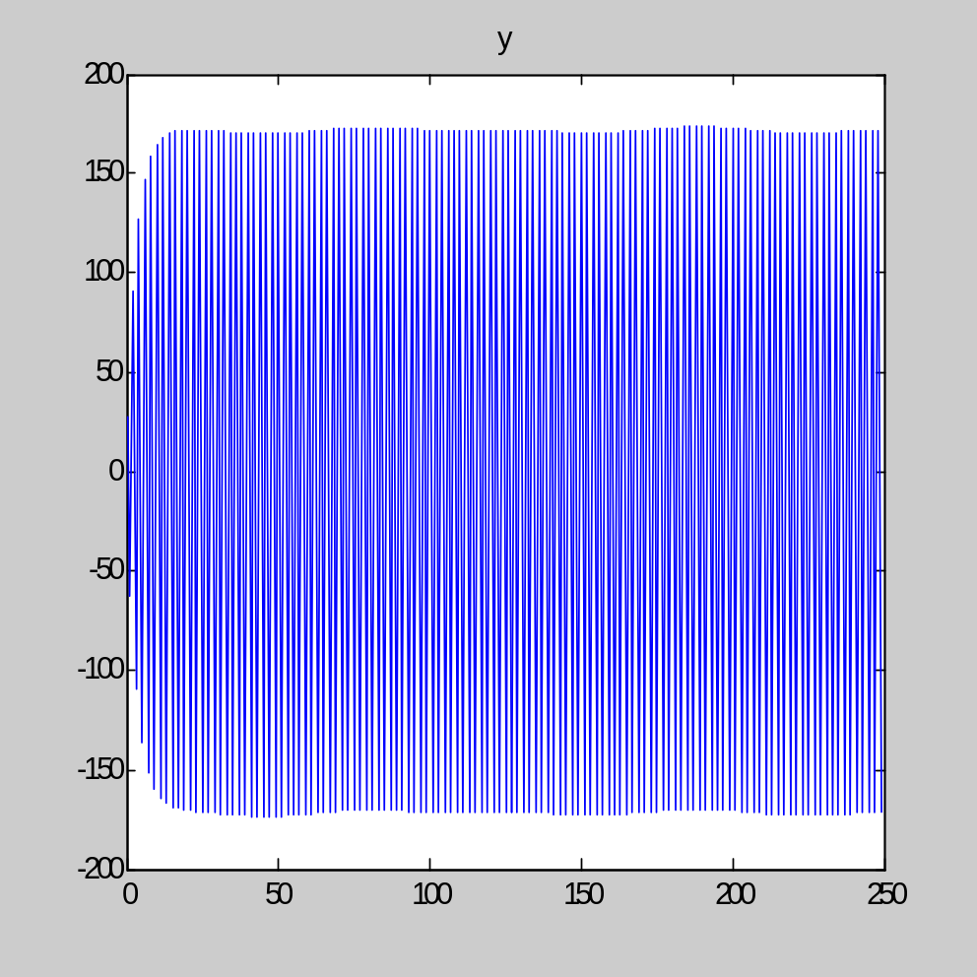

Slide 21
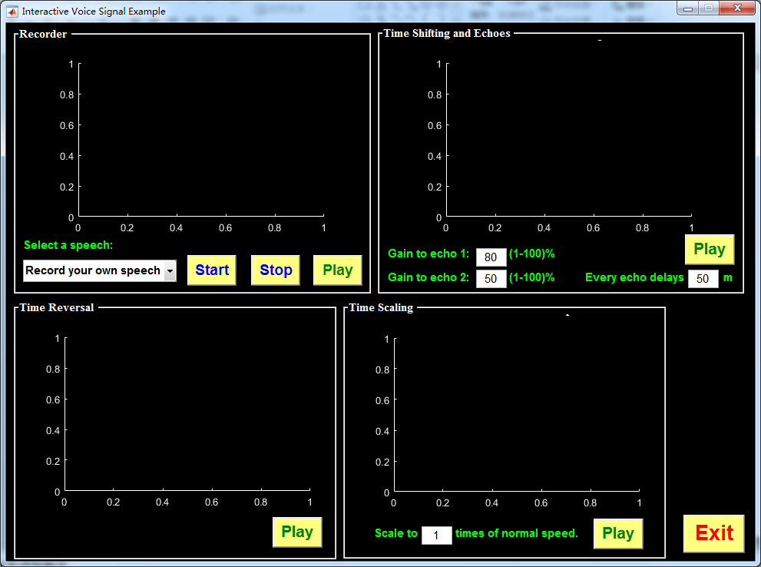
3. Transformations of the independent variable
>>trnsfm

